Slide 1



Volodymyr Dahl
East Ukrainian
National University
Faculty of Law
UNIVERSITY PROFILE
The date of foundation
Total number of students
(as per 2022)
Number of international students
(as per 2022):
March, 27, 1920
5250 of people
120
Location
Positions in ratings
Strong Areas
before the 2014 – Luhansk, with branches in Luhansk and Kherson oblasts, AR Crimea; after the 2014 – Severodonetsk, Luhansk oblasts with branches in Rubizhne, Luhansk oblast; after the 24th of February 2022 – evacuation to locations in Kamyanets-Podilskiy Khmelnitsk oblast, Dnipro and Kyiv
51st place in national rating TOP-200 Ukraine: 7th place in national rating of HEI by the number of patents received in 2022; 48th place among HEI of Ukraine in terms of SciVerse Scopus database; entering the QS Emerging Europe and Central Asia University Rankings in 2021
transport technologies, chemical engineering, automation, materials science, computer science, social sciences, economics and law; experience in participating in regional development projects, implementation of social and public projects

Slide 2

FACULTY OF LAW PROFILE
The date of foundation
Total number of students
(2024)
1992
400 of people
Levels of education
Strong Areas
Location
Law
political science
international relations
history
archeology
cultural studies
tourism and recreation
before the 2014 – Luhansk, with branches in Luhansk and Kherson regions, AR Crimea; after the 2014 – Severodonetsk, Luhansk region with branches in Rubizhne, Luhansk region; after the 24th of February 2022 – evacuation to locations in Kamyanets-Podilskiy Khmelnitsk region, Dnipro and Kyiv
Bachelor
master's degree
postgraduate student

Slide 3
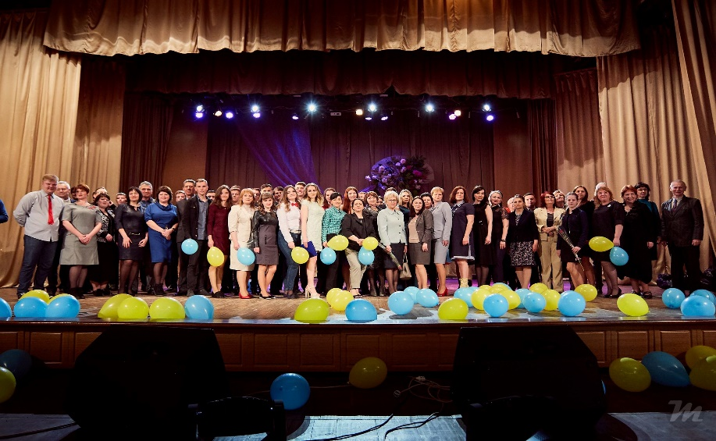
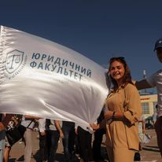
Faculty of Law
Best Practices and Achievements
"Electronic legal office" project. Grant competition "Improving access to justice in selected communities of Donetsk and Luhansk regions", ISAR "Unification“ (2019).
Project "Monitoring of trials related to armed conflict as an educational and research tool for the training of law students (UN RPP)" (2021).
Scientific and analytical research "The impact of civil-military administrations on the development of communities in eastern Ukraine (Luhansk region)" within the framework of IB 22-011, implemented with the support of the Konrad Adenauer Foundation in Ukraine (2022).
The project "MediaClub Pro Bono: innovative, legal and youth media studio" is implemented within the framework of the UN Program for Reconstruction and Peacebuilding with the financial support of SDC (Swiss agency for development and cooperation) (2021).

Slide 4

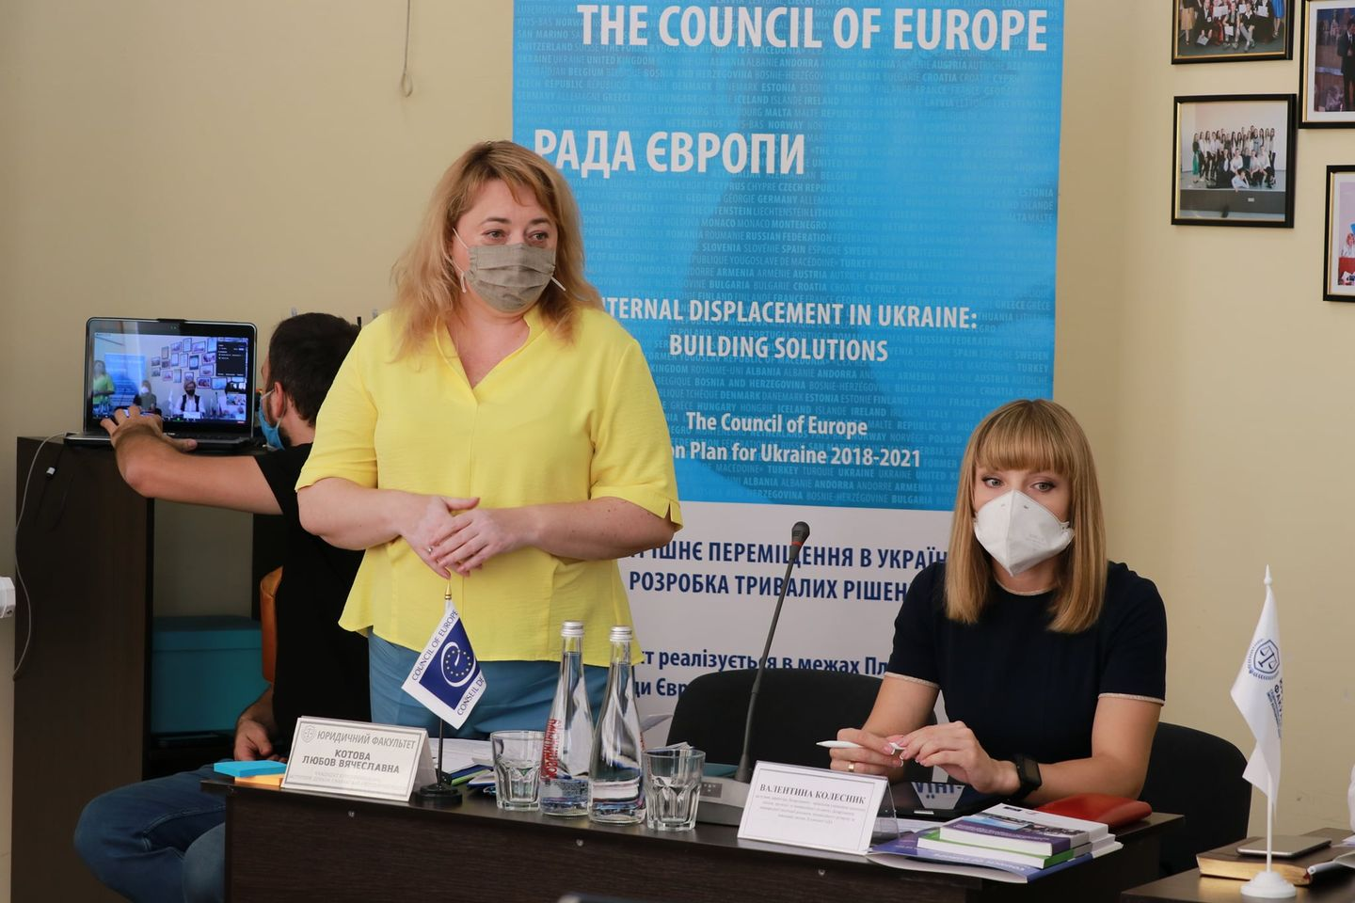
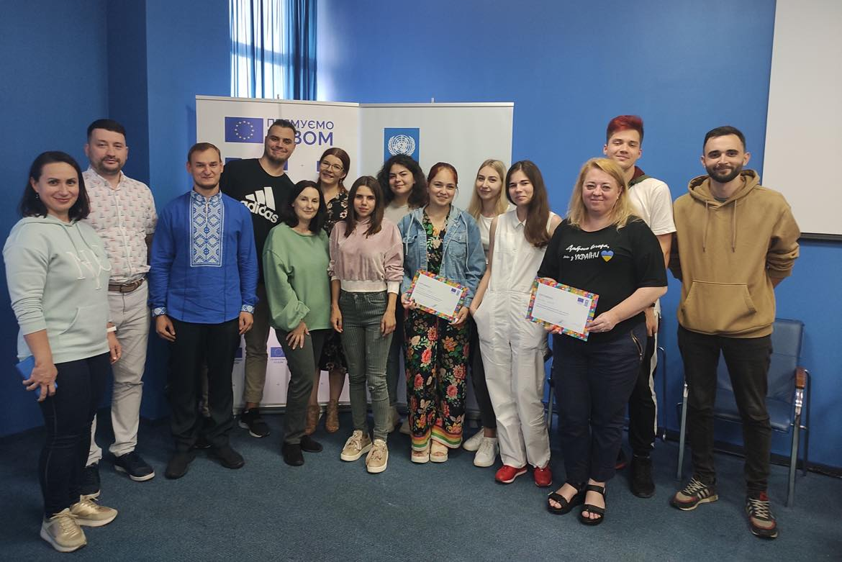
Faculty of Law
Best Practices and Achievements
Council of Europe project "Internal Displacement in Ukraine: Developing Durable Solutions" of the European Training Program on Human Rights for Lawyers (HELP) as experts and certified trainers of the Council of Europe on internal displacement within the framework of the European Training Program on Human Rights for Lawyers (HELP) (2021, 2022).

Slide 5
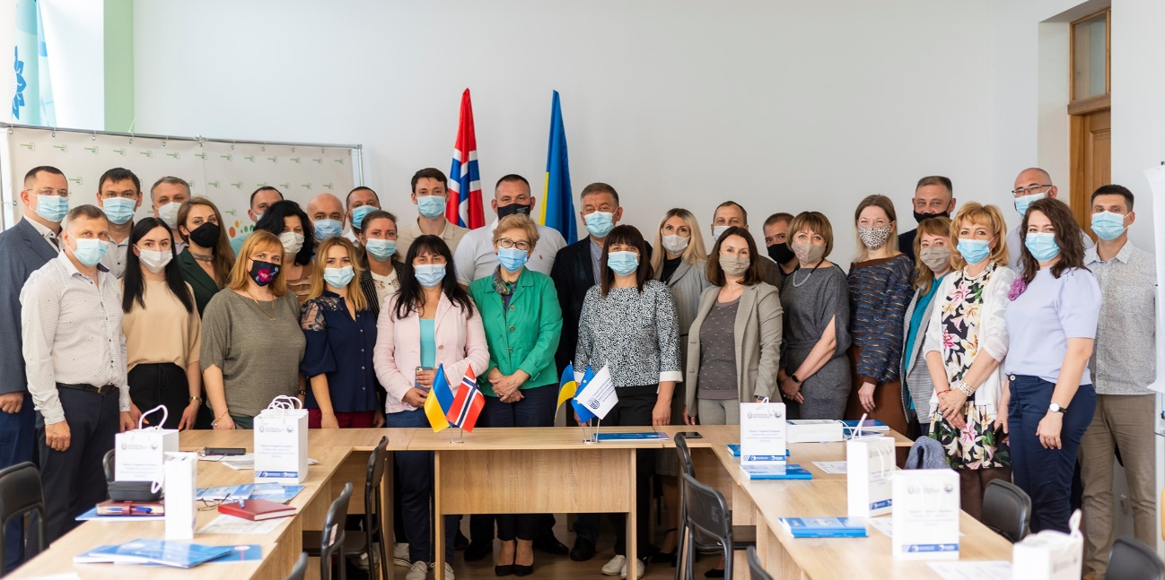
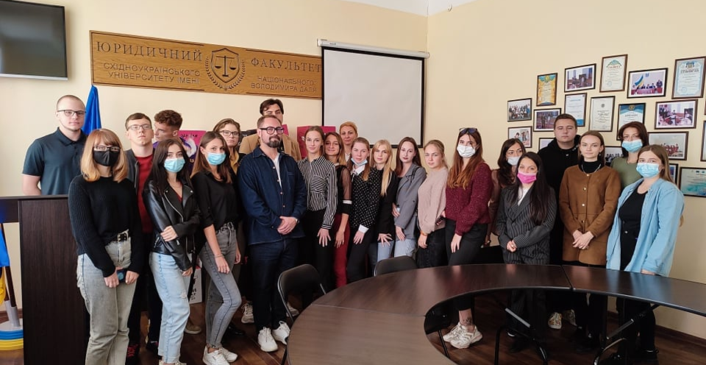
Faculty of Law
Best Practices and Achievements
Analytical report on ensuring the rights of people with disabilities and low-mobility groups to access to quality higher and professional higher education in Luhansk region" jointly with the NGO Women's Initiative Foundation within the framework of the Mentoring Program to strengthen the advocacy capacities of civil society organizations (ISAR Ednannia, Ukrainian Center for Independent Political Research (UCIPR) and Center for Democracy and Rule of Law (CEDEM) (2021).

Slide 6
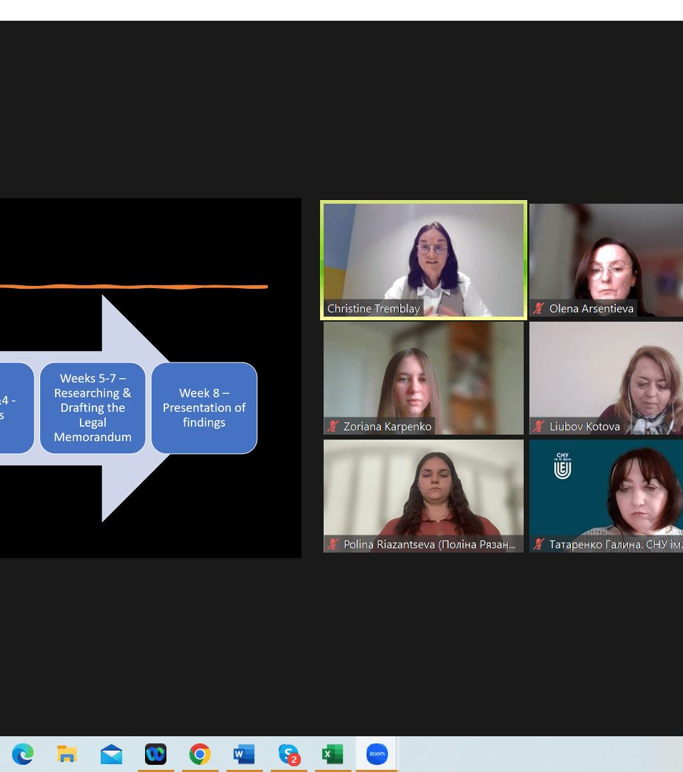
Faculty of Law
Best Practices and Achievements
The project "Norway-Ukraine. Professional adaptation. Integration into the state system" for war veterans and their families with the financial support of the International Foundation for Social Adaptation and the Ministry of Foreign Affairs of the Kingdom of Norway (2021-2022).
COIL Project “Sexual and gender-based violence during conflict: understanding those crimes and how gender biases negatively impact their investigation and prosecution" (The Hague University of Applied Sciences and Volodymyr Dahl East Ukrainian National University, 2024)
Project "Formation and realization of digital rights in education, science and business for economic recovery“ (2024)
Рroject for the social adaptation of displaced persons and other segments of the population affected by the consequences of the armed conflict in the Sviatohirsk community (Donetsk region, de-occupied territory).

Slide 7
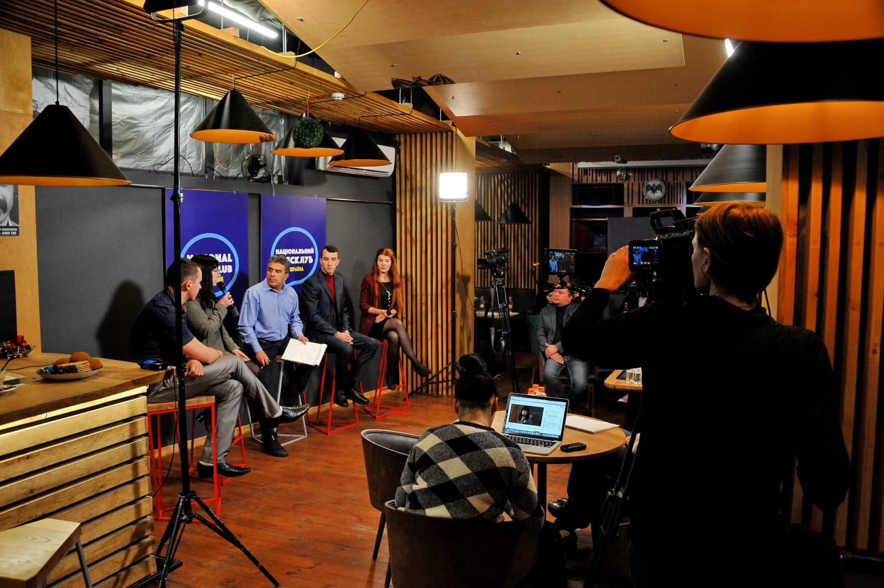
Faculty of Law
Centers and laboratories
Debate club
The goal is to increase the level of argumentation, public speaking, critical thinking, and the ability to listen and respect other points of view among participants.
Participation in the public debate "The SCORE Index and its impact on increasing the level of cohesion and social unity in communities«
Participation in the project as part of the third module of the Television Debate Lab program, organized by the United Nations Recovery and Peacebuilding Programme in cooperation with the Ministry of Culture, Youth and Sports and the Souspilnist Foundation with financial support from the governments of Denmark, Sweden and Switzerland.

Slide 8
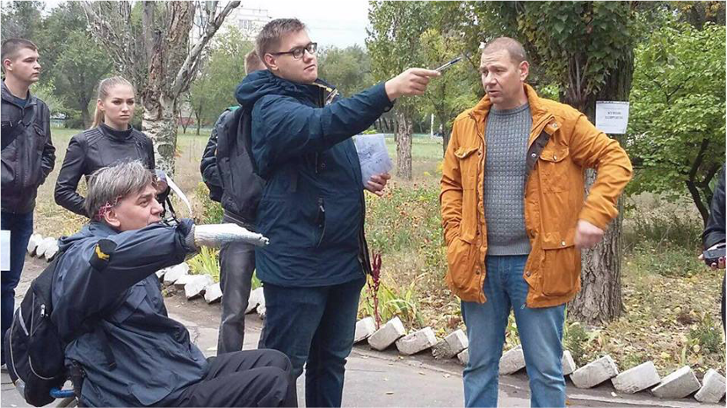
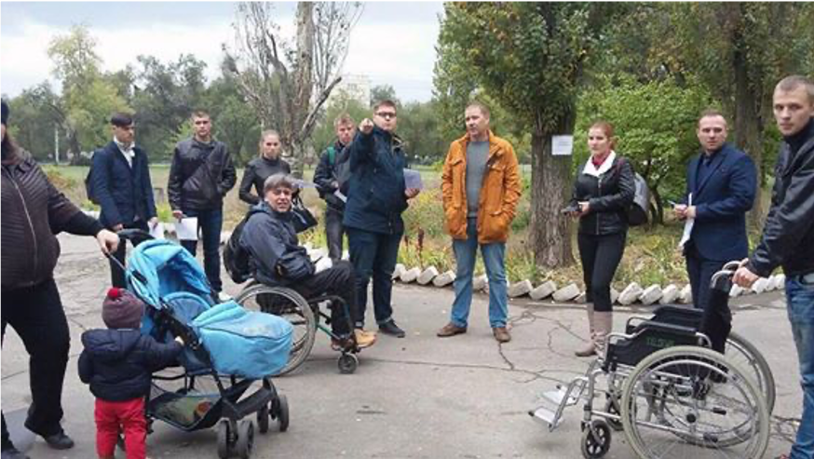
Faculty of Law
Social projects. Inclusion.
A social experiment on the accessibility of the area near the Volodymyr Dahl National University was conducted with the participation of volunteers (students of the Volodymyr Dahl National University Law Faculty), people with disabilities, and people with limited mobility regarding the architectural accessibility of educational and vocational institutions in Luhansk region (2017)
Project to create physical accessibility for students with disabilities (2018)
Analytical Report on Ensuring the Rights of Persons with Disabilities and Low-Mobility Groups to Access Quality Higher Education in Luhansk Oblast" jointly with the NGO "Women's Initiatives Foundation" and the Gender Centre as part of the Mentoring Programme to Strengthen the Advocacy Capacity of Civil Society Organisations (2022).

Slide 9

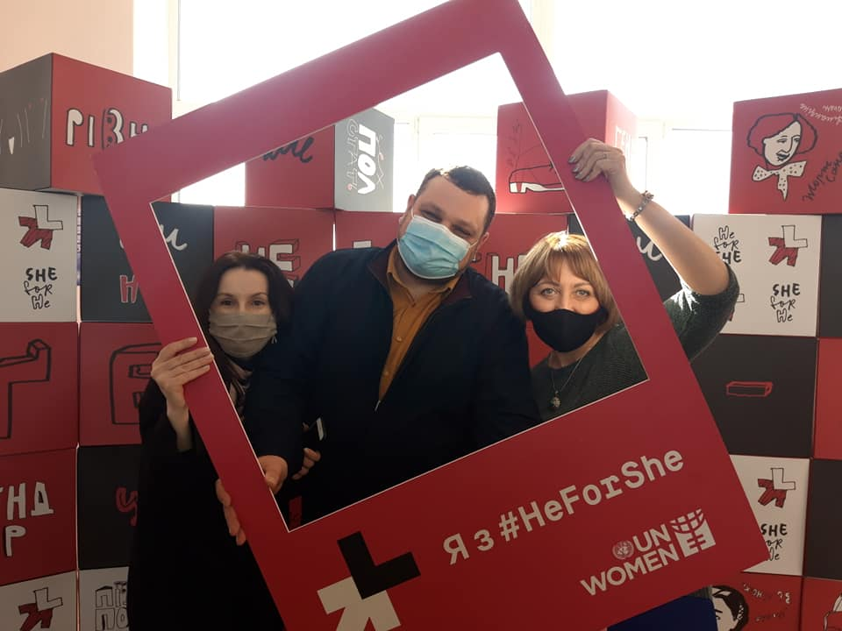
Faculty of Law
Centers and laboratories
The Center for Gender Culture
https://snu.edu.ua/index.php/subdivision/tsentr-gendernoyi-kultury-snu-im-v-dalya/
Professor Halyna Tatarenko
research and presented the results of "Gender in the Legal Profession" and took part in the preparation of a section for the scientific and industrial publication "Beijing+25: Parallel Report. Ukraine 2014-2019“

Slide 10
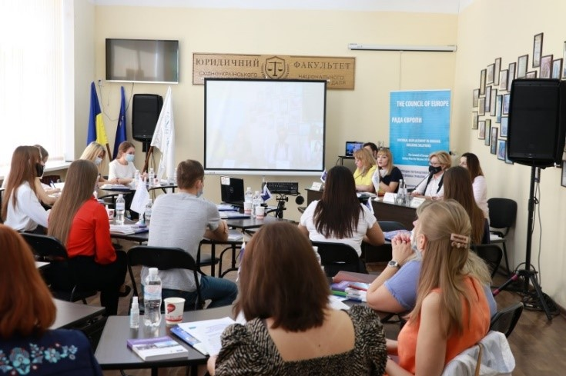
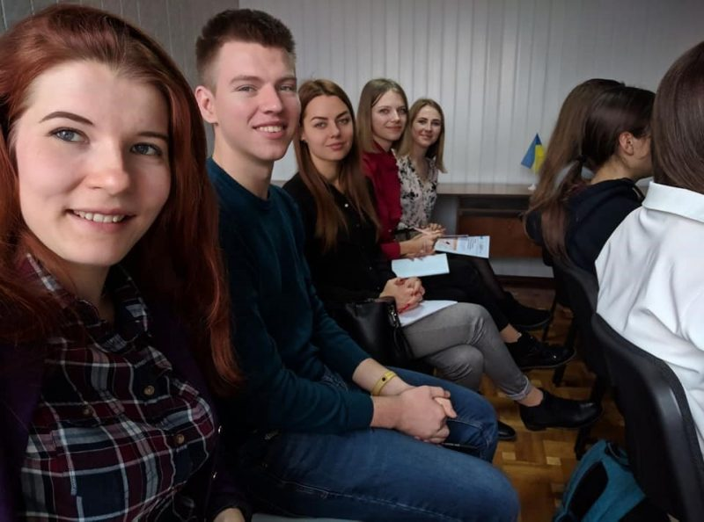
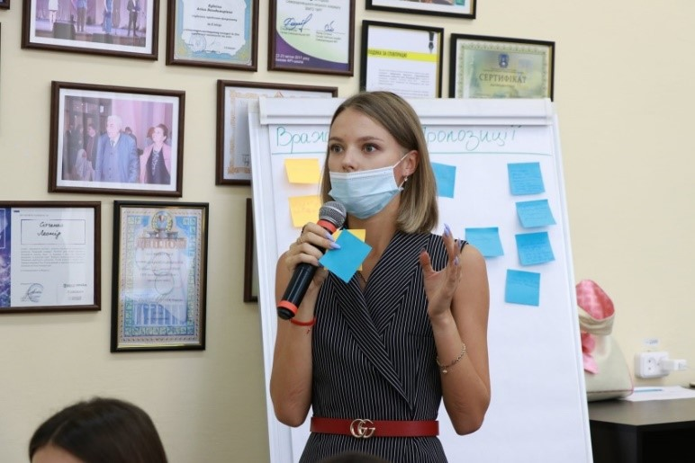
Faculty of Law
Centers and laboratories
Legal clinic "PRO BONO"
Member of the Association of Legal Clinics of Ukraine
Developing students' practical skills in counselling and legal argumentation, building legal arguments, drafting legal documents
Providing legal aid to certain categories of citizens (displaced persons, war veterans, military personnel, persons affected by war)
Legal education projects
Consul-touch model consultancy
http://pravo-snu.com.ua/clinic/
https://snu.edu.ua/index.php/subdivision/jurisprudence/
https://www.facebook.com/eunu.law.probono/

Slide 11
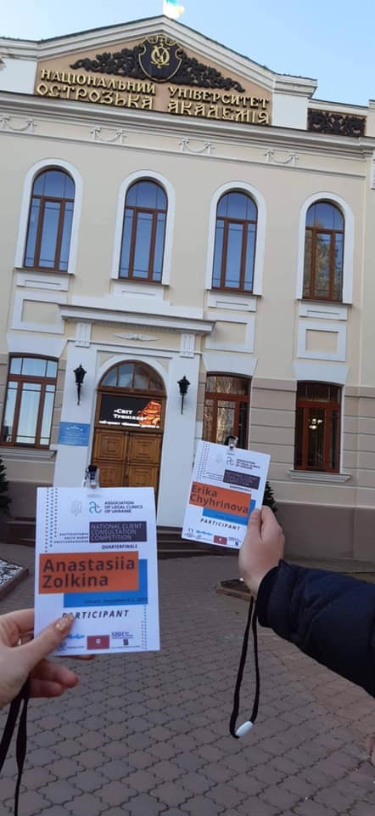
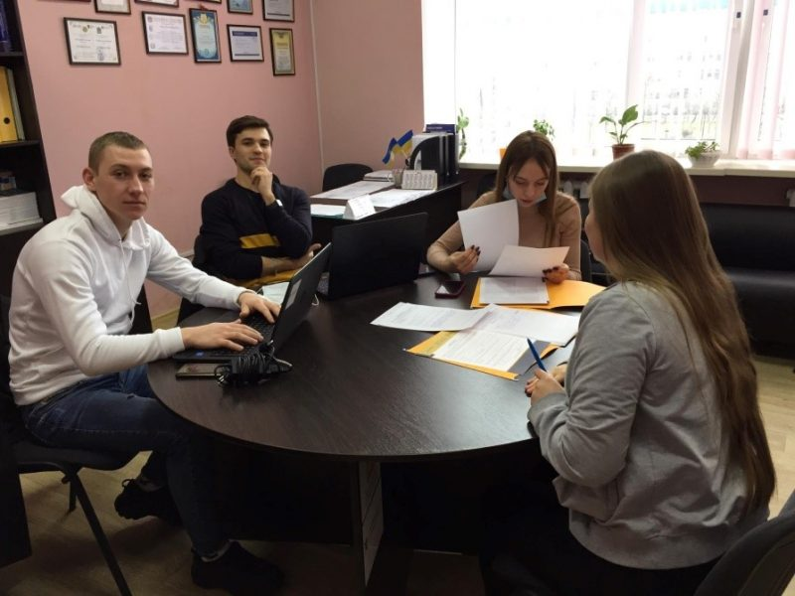
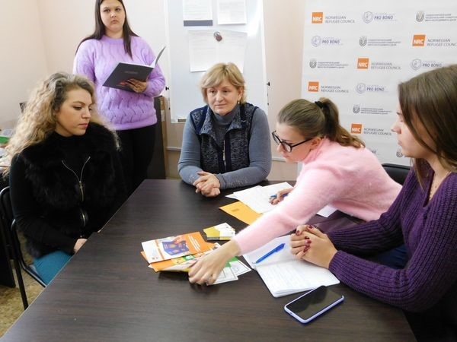
Faculty of Law
Centers and laboratories
Legal clinic "PRO BONO" projects
Cooperation with the Norwegian Refugee Council: trainings for representatives of legal clinics within the framework of the "Information, Counseling and Legal Assistance" (ICLA)
Pilot internship programme for students at the Norwegian Refugee Council (the only one in Ukraine)
Development of an interactive training manual "Methodological materials on humanitarian law in the context of the armed conflict in the East of Ukraine"
Participation in the Council of Europe project "Internal Displacement in Ukraine: Developing Durable Solutions«
The project "Legal Clinic Consultations for Consumers of Financial Services", implemented by the Association of Legal Clinics of Ukraine

Slide 12

Faculty of Law
Specific proposals for cooperation
1) Projects to protect human rights during armed conflicts: international legal and national aspects.
Study of the peculiarities of investigation and prosecution of the crime of genocide
Application of conventional mechanisms for the prevention and punishment of crimes against humanity
Problems of improving the norms of international humanitarian law in the light of modern armed conflicts
2) Gender policy of the European Union: general principles and practice of implementation
Implementation of gender approaches in the activities of state authorities, local self-government bodies and NGOs as a principle of decentralisation: experience of Ukraine and foreign countries.
3) Issues of inclusive education (education of people with disabilities, education of the elderly, education of internally displaced persons as a result of the war with the Russian Federation, and persons affected by the war with the Russian Federation).
Digital inclusion and accessibility
4) Digital rights and responsibilities in education, science and business for economic recovery

Slide 13

Faculty of Law
Specific proposals for cooperation
Legal Advice Centre at Royal Holloway
"Comparative study of access to justice and legal aid for vulnerable groups in the UK and Ukraine" (joint comparative study of legal problems faced by vulnerable groups in the UK and Ukraine, development of strategies and recommendations to improve access to justice and legal aid in both countries. The focus is on identifying and overcoming barriers to access to legal services faced by vulnerable groups, including refugees and internally displaced persons
For research clusters: Crime and Punishment; Families and Children; Health and Social Care; Rights and Freedoms.
Legal support for social and professional adaptation and the right to entrepreneurship for war veterans
Transitional justice and peacebuilding in the post-conflict period (experience of post-conflict states for peacebuilding in Ukraine)
Gender-based violence as a manifestation of gender inequality and human rights violations in the context of armed conflict (based on the situation in Ukraine).

Slide 14
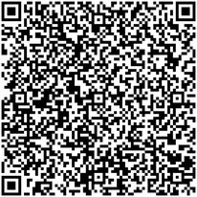
Faculty of Law
Contacts
Dean of the Faculty Olena Arsentieva
+380506269192
arsenteva@snu.edu.ua
https://www.facebook.com/profile.php?id=100000534696951
Head of the Center for Gender Culture Halyna Tatarenko
+380501589273
tatarenko@snu.edu.ua
Head of the Legal clinic "PRO BONO" Viktoriia Zholudieva
+380668804349
zholudieva@snu.edu.ua
https://snu.edu.ua/index.php/subdivision/jurisprudence/
http://pravo-snu.com.ua/
https://www.facebook.com/eunu.law

